Slide 1
Dice Pip Detection
James Young

Slide 2
Motivation

Slide 3
Overview of Process
Get and convert foreground and background to grayscale
Subtract BG from FG
Gaussian blur
Otsu threshold
Canny edge detection
Find contours
Iterate through contours
Use contours to obtain bounding boxes
Crop out and resize bounding boxes from original image
Secondary grayscale conversion, gaussian blur, and Otsu threshold
Bucket fill corners
Blob detection, count blobs

Slide 4
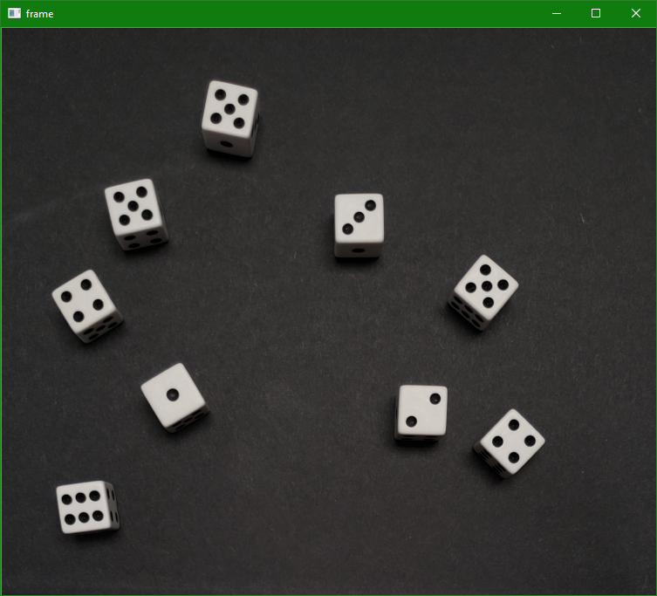
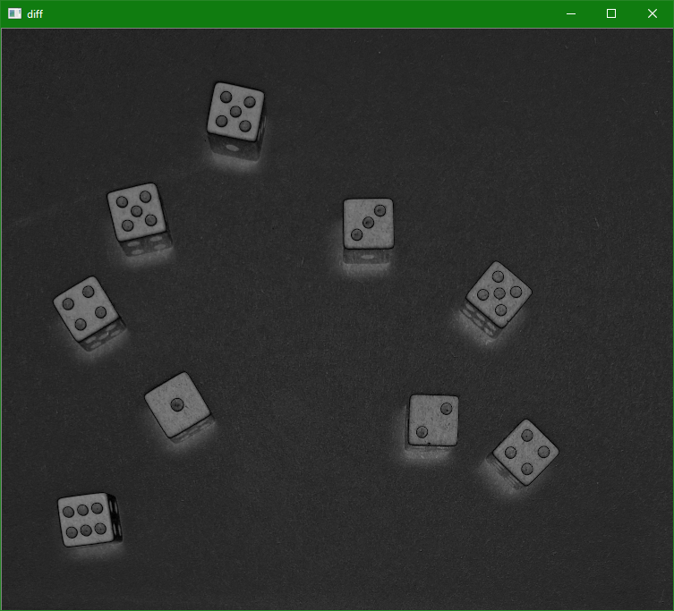
Foreground - Background

Slide 5
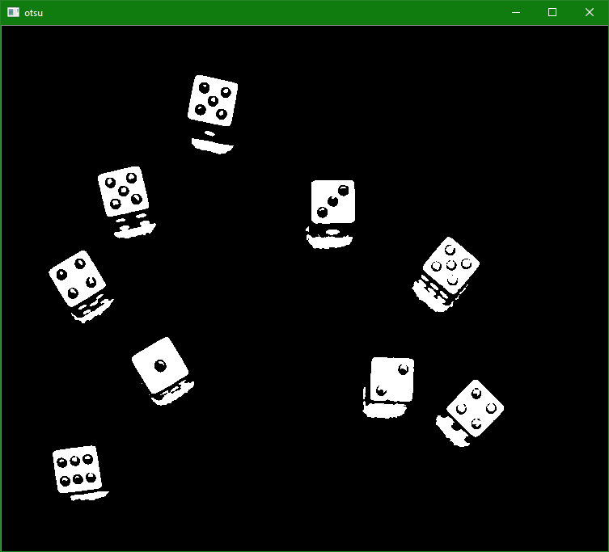
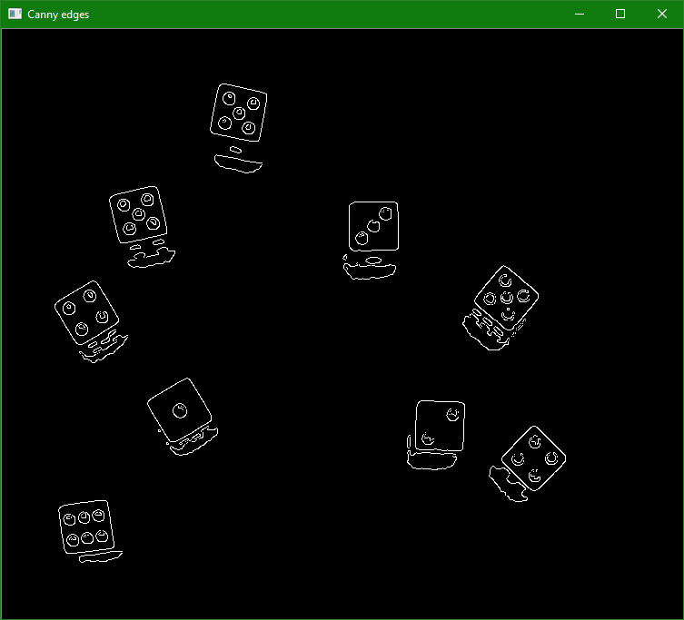
Otsu Threshold and Canny Edge Detection

Slide 6
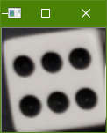
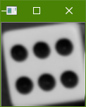


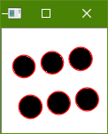
Iterate through closed contours and isolate pips
Crop out die
Gaussian Blur
Otsu Threshold
Bucket Fill
Corners
Count Pips
via
Blob Detection

Slide 7
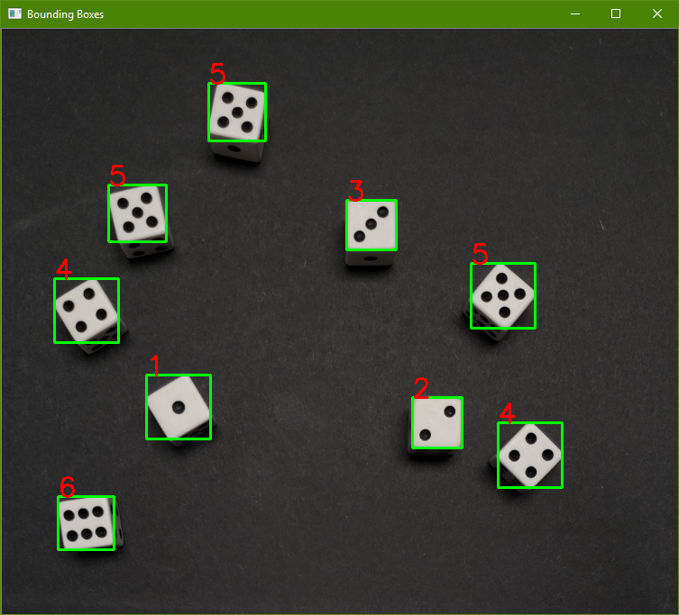
Draw Bounding Boxes and Pip Count

Slide 8
Problems Faced
Lighting
Solved by heavy constraints
Small Gaps in Contours
No easy solution
Overlapping and Directly Adjacent Dice
Might not need to be solved
Other small issues

Slide 9
Future Work
Improve detection/fix bugs
Broaden detection scope (colored dice, numbered dice)
Machine Learning approach

Slide 10
Questions?

Slide 11
Applications

